Slide 1
Asset Management System
Chennai, Oct’25 2018, The Legal Eliminators

Slide 2
Contents (Asset Management System)
TEAM MEMBERS
OVERVIEW
ACTORS
DELIVERABLES PRODUCED
TEST CASES
USECASE
REQUIREMENT ITEMIZATION
DFDR
APPLICATION LINK
TEST CASE ADEQUACY
TEST CASE EFFECTIVENESS
PROJECT STATISTICS
TRACEABALITY MATRIX

Slide 3
Team Members (Asset Management System)
Pranav Singh Team Leader
Worked on Test Cases
Worked on Use Cases
Reviewed/Managed the team
Sapna Sahu Test Engineer
Worked on Test Cases
Worked on Defect Reporting(DFDR)
Worked on Use Case Diagrams
Rashmi Karagudri Test Engineer
Worked on Defect Reporting(DFDR)
Worked on RVFD
Worked on Use Case Specification

Slide 4
OVERVIEW
This project is aimed at developing Online Asset Management System. This is an Intranet based application that can be accessed throughout the organization and this is a web based application that can be accessed over the web.
This system can be used to search for an asset based on search condition, assign a hardware asset to/from an employee based on request, insert new asset details, modify an existing asset details and display all asset allocation request details.
This is an integrated system that contains both the user (Manager) component and the Admin component.
http://ndafile:8081/AssetManagementSystem_Spring/index.html

Slide 5
ACTORS (Asset Management System)
Asset ManagementSystem
MANAGER
ADMIN
Managers should be able to
The administrators should be able to
Asset Management System is able to
Login to the system using his/her credentials
Raise a request for allocation of asset to an employee, by filling up the asset requisition form that auto generates the asset request ID.
View the status of request, based on the asset request ID
Login into the system using his/her credentials
Include new asset/modify asset details from the inventory.
Approve/Reject a request.
Generate various reports
Also export the assert details data into an excel sheet.
This is an integrated system that contains both the user (Manager) component and the Admin component.
It can be used to search for an asset, assign a hardware asset to/from an employee on request, insert new asset details, modify an existing asset details.

Slide 6
Deliverables Produced (Asset Management System)
Test Cases
Use Cases
RVFD
DFDR
A test case is a set of conditions or variables under which a tester will determine whether a system under test satisfies requirements or works correctly.
The process of developing test cases can also help find problems in the requirements or design of an application.
LINK: AMS TEST CASE
A use case is a methodology used in system analysis to identify, clarify, and organize system requirements.
The use case is made up of a set of possible sequences of interactions between systems and users in a particular environment and related to a particular goal.
A use case can be thought of as a collection of possible scenarios related to a particular goal, indeed, the use case and goal are sometimes considered to be synonymous.
LINK: AMS USE CASE
Requirements validation is an iterative process which takes place throughout the lifecycle of the project.
During elicitation, analysis and specification you should constantly be questioning and clarifying the data given to you in order to check its validity.
This will ensure that the SRS that you produce is complete, consistent and ready for the formal validation process.
LINK: AMS RVFD
A defect is an error or a bug, in the application that causes it to produce an incorrect or unexpected results.
A programmer while designing and building the software can make mistake or error.
These mistakes or errors mean that there are flaws in the software, these are called defects and the report written for logging these defects is called a defect report.
LINK: AMS Defect

Slide 7
TEST CASES
LOGIN
Manager
Raise a Request
View Status
Admin
View Request
Add/Modify Asset
Approve/Reject Request
Export data into Excel sheet

Slide 8
Requirements Validation
&
Functional Decomposition
File Handling
Storage of information
Termination
End process
Implicit
Efficiency
Invocation
Start process
RVFD
Explicit
User specified
System
Minimum specifications
Security
For confidentiality
Query
improvements
Error Handling
consistency

Slide 9
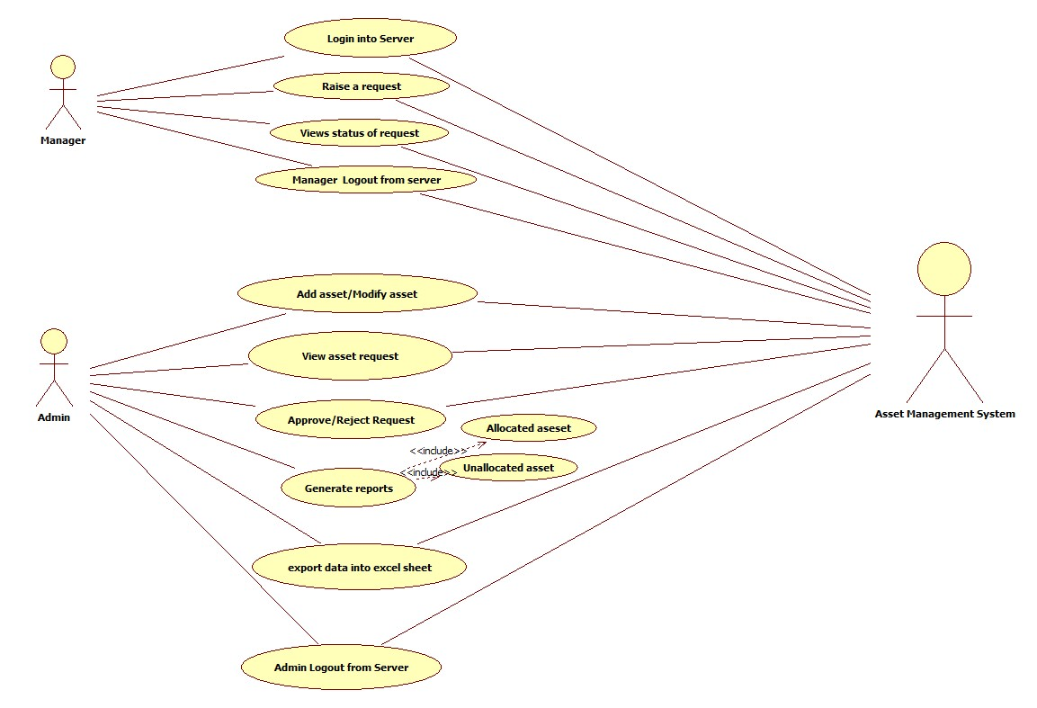
USE CASES
(Overall)

Slide 10
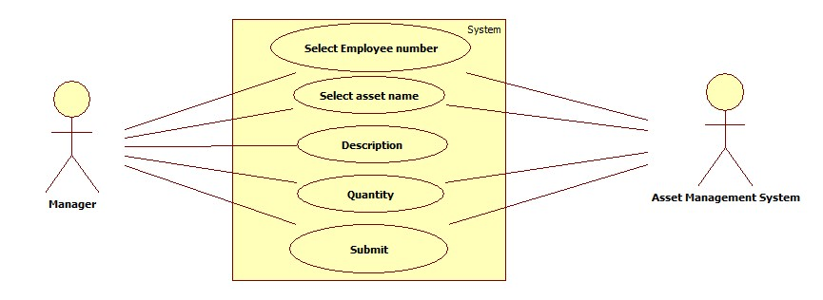
USE CASES
(Raise Request)

Slide 11
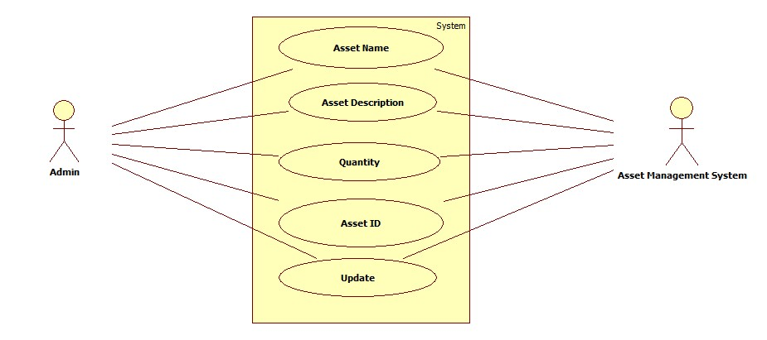
USE CASES
(Update/Modify Asset)

Slide 12
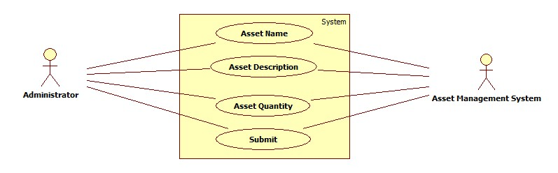
USE CASES
(Add Asset)

Slide 13
The system does not display appropriate error message on entering invalid username and invalid password
Some of the links present in all the pages is not navigating the user to proper web page
There are some common spelling mistakes in all the pages
The manager is found to raise a request even with entering invalid values in the Asset details fields
The manager is found to raise a request even with entering null values in the Asset details fields
The user is able to view status of raised request even with entering invalid Emp No.
DEFECTS FOUND
(MANAGER)

Slide 14
The system does not display appropriate error message on leaving both the username and password fields as blank
The system does not display appropriate error message on entering invalid username and invalid password
Some of the links present in all the pages is not navigating the user to proper web page
There are some common spelling mistakes in all the pages
The system does not display appropriate error message on leaving asset details fields as blank
The system does not display appropriate error message on entering invalid values in asset details fields
DEFECTS FOUND
(ADMIN)

Slide 15

APPLICATION LINK
http://ndafile:8081/AssetManagementSystem_Spring/index.html

Slide 16
This defines the number of actual test cases created vs estimated test cases at the end of test case preparation phase. It is calculated as
Test Case Adequacy = No. of actual Test cases*100/No. of estimated Test cases estimated
= (93*100)/200
= 46.5
Test Case Adequacy

Slide 17
This metrics defines the effectiveness of the test cases which is measured in terms of the number of defects found in testing with using the test cases.
Test Case Effectiveness = No. of defects detected using test cases*100)/total no of defects detected in testing
=(14*100)/28
=50
Test Case Effectiveness

Slide 18
Project Statistics
Number of Test Cases = 93
Number of Test Cases Passed
= 65
Number of Test Cases Failed
= 28
Number of Defects Logged
= 14
Number of Use Cases
= 7

Slide 19
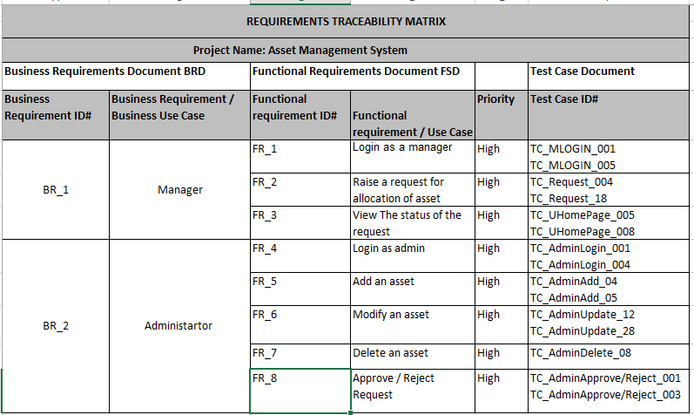
Traceability Matrix

